Slide 1
Ancestor
Track = Education
Ratan Kumawat. (Leader)
Kashit Duhan
Mahesh
...Welcome and join with us and watch our PPT...

Slide 2
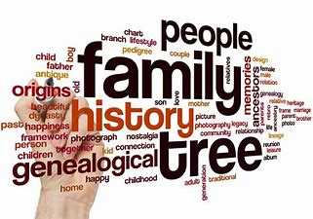
Problem Statement.
We all have our Ancestors but we don't know from where they have come or how they have come and do we really resembles to the people living around Us??
The same is with plants animals living non living things??

Slide 3
Solution:-
→>> We Have the simple Solution to connect the people and help understand there ancestor and there history in this world.
-- >> Join the plants and Animals species and find the best habitat for them to protect the local species.
→>> We want to come with website, Apps, Game and Books and articles and journals.

Slide 4
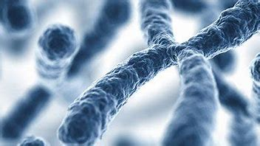
Why we??
⇒ We will keep the Records of the world plants and animal species.
⇒ Help people to see the surname connections around the world.
⇒ keep track of the natural or artificial incidents of the world on the genes.
⇒ work in field of plants and animals to get the maximum productivity.

Slide 5
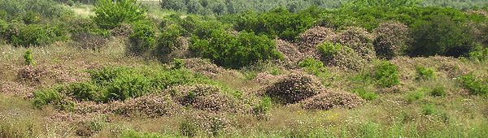
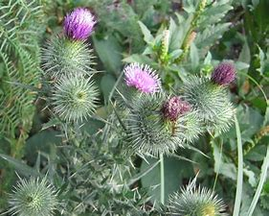
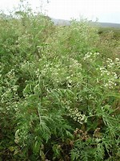
Incident for the plants..
1.Lantana growing in abandoned citrus plantation; Moshav Sdei Hemed, Israel.
2.Parthenium hysterophorus smothering native flora in Achanakmar Tiger Reserve, Bilaspur, Chhattisgarh, India
3.A mature Scotch thistle, an invasive weed in Australia

Slide 6
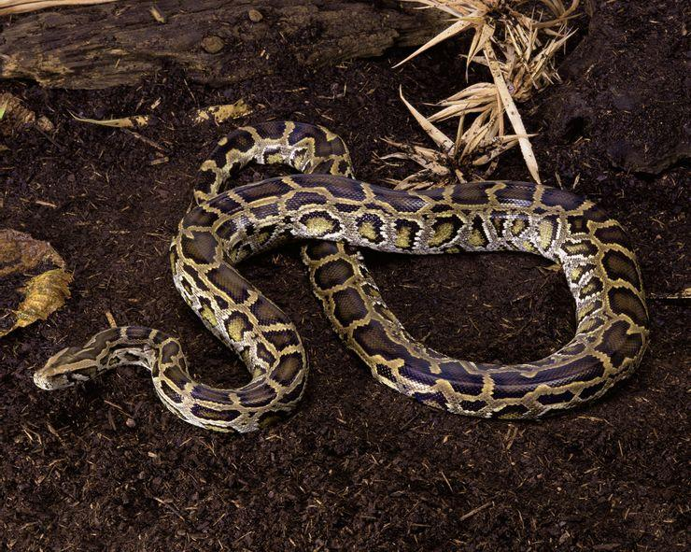
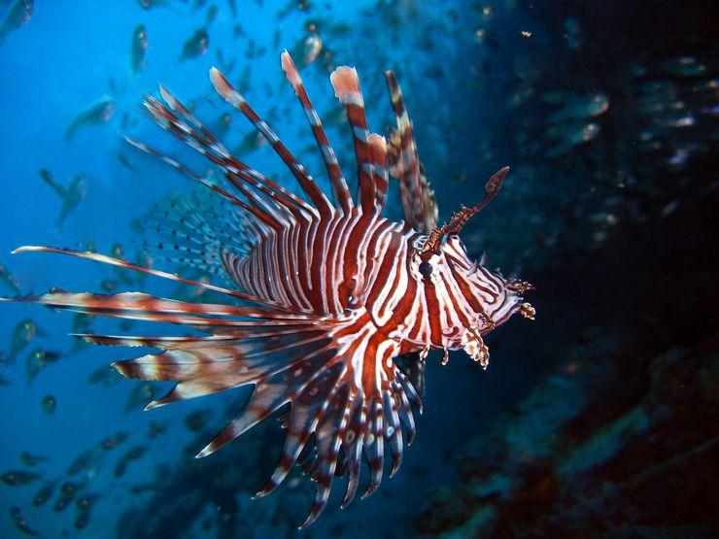
Incident with Animal species..
Burmese Python a snake species which was first found in S.America now taking over the texas and florida
Lionfish is a species of fist firstly which was founded in africa now it have a large population over east coast.

Slide 7
How to implement this on people.
We plan to make a track record of the all the species and record there habitachual changes.
Make a website to provide the resources and take the information for the users and their experience with this conditions..pC
NMake Games and Apps for the better understanding for the new generation and the non history and biology background students and people.YCM
Quotes for illustration purposes only

Slide 8
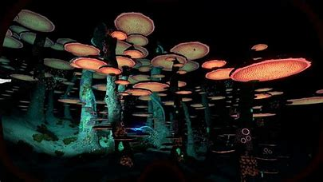
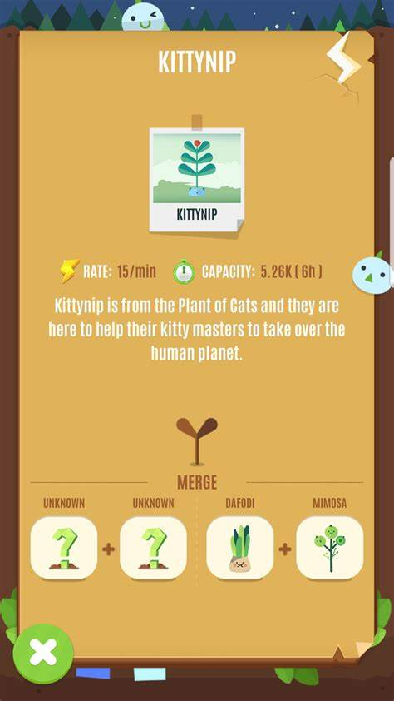
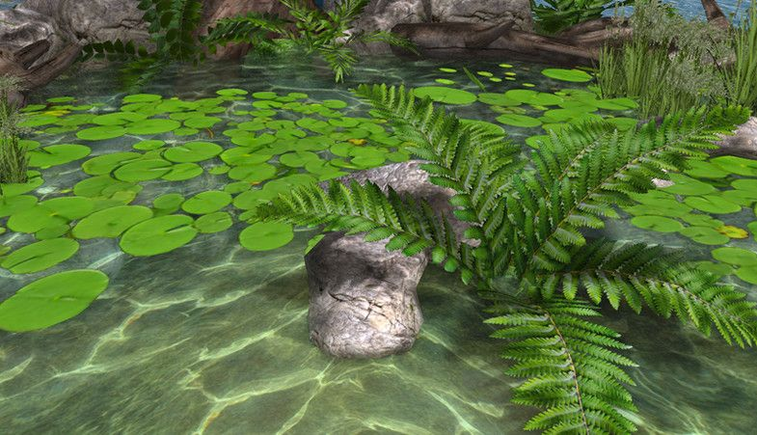
Our games what we are working on
This are the 2 Games that we have started to work which will help us to teach the people about plants and animals and human interaction and their interdependence on each other

Slide 9
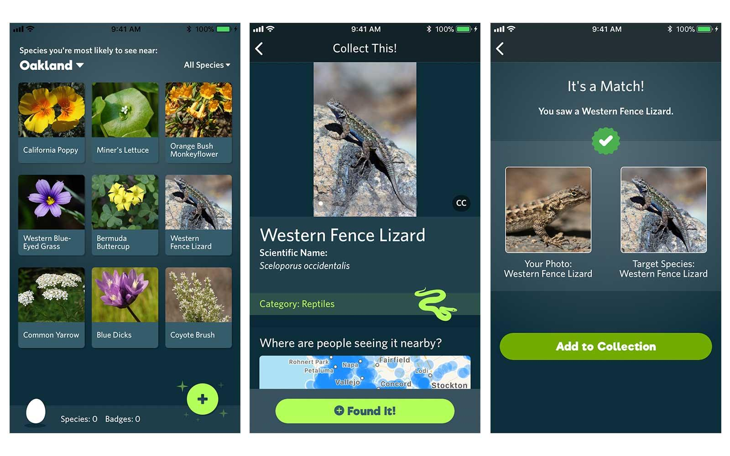
.
Our App initiative...
This is out photoshop of our App we want to make.
For the more reach of our plan.

Slide 10
Websites and Data storage and research for the new species and better production.
1.Government, plants and Animals bio spears and habitats and zoos
2.international funders like Animal and plants organizations..

Slide 11
Thanks for being with us in the ppt….

